Slide 1


Strategy & Ops goals

Slide 2
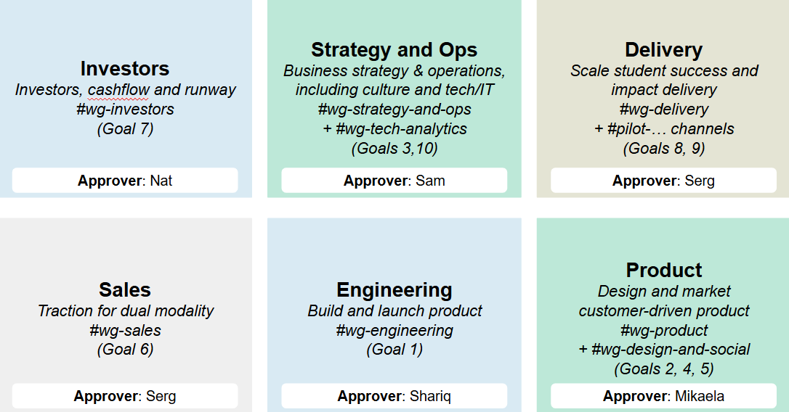
DACI

Slide 3
Strategy & Ops WG Goals
Vision: Forte is a well-run business. That means:
Strategy: Our path forward is both profitable and attainable, because we
Culture: have efficient, effective, and enjoyable team infrastructure and processes, which
Tech/Analytics: serve and empower our internal and external stakeholders in a data-driven way.
Current drivers: Sam, Adya, Jace respectively

Slide 4
Strategy & Ops WG Tasks
2024
2025
2026
Q4
Q1
Q2
Q3
Q4
Q1
Strategy:
Execute Pivot
Product/Strategy Review
Investment strategy
Budget & Staff Planned
Fundraise Support
We are an ARR org.
Culture:
Ways of Working
Scaling culture to new teammates
Bigger culture reset
Retreat
Tech/Analytics:
Delivery at scale plan
Non-Dev customer functions live
Plublish external experise
Sales & delivery dashboard actionable
Non product processes automated
Mobilize
Execute

